Slide 1

Homework 8 Nmap Zenmap INT4023
Dalton Murray

Slide 2
Information

Slide 3
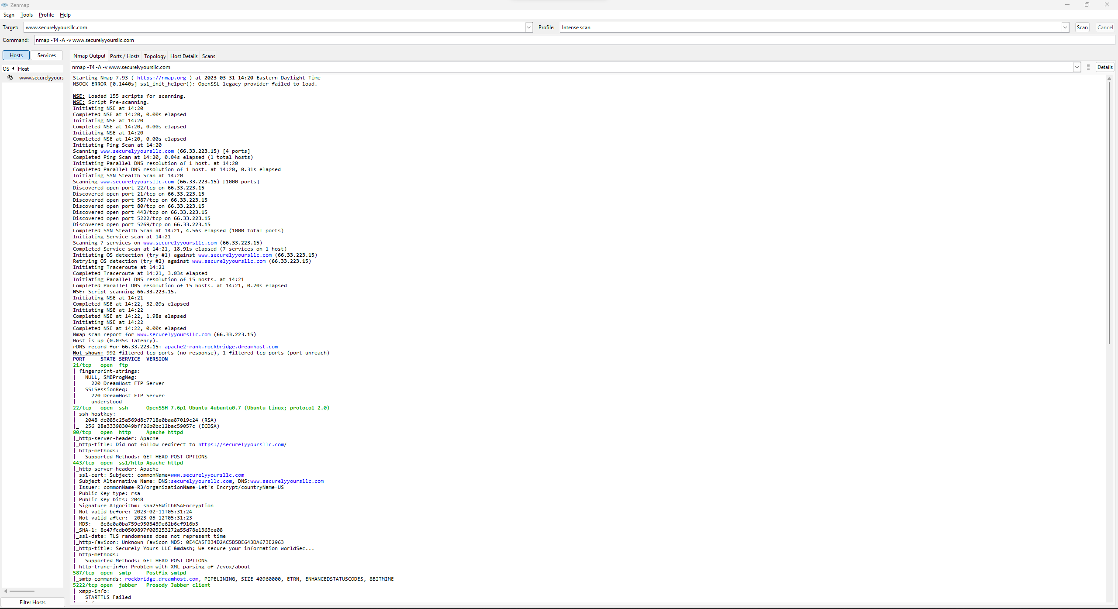
Nmap - Output
https://paste.gg/p/anonymous/758d356091c2408c83df327a3b0d8bc0

Slide 4
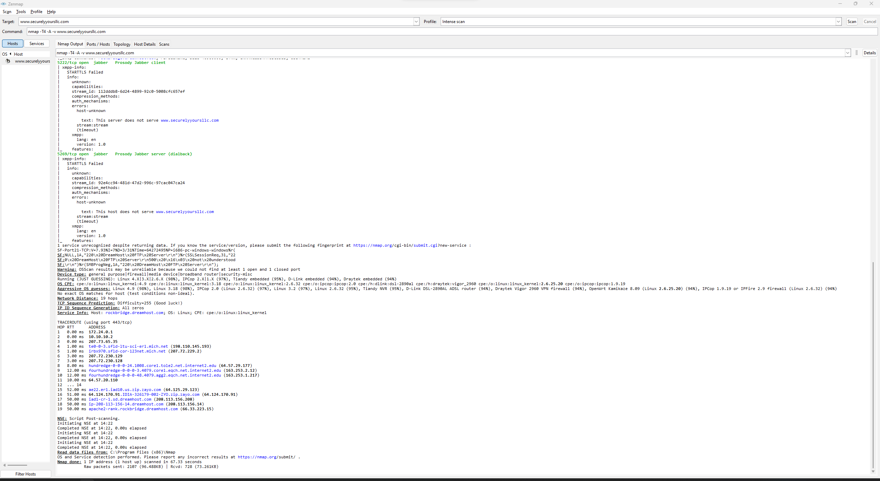
Nmap – Output 2

Slide 5
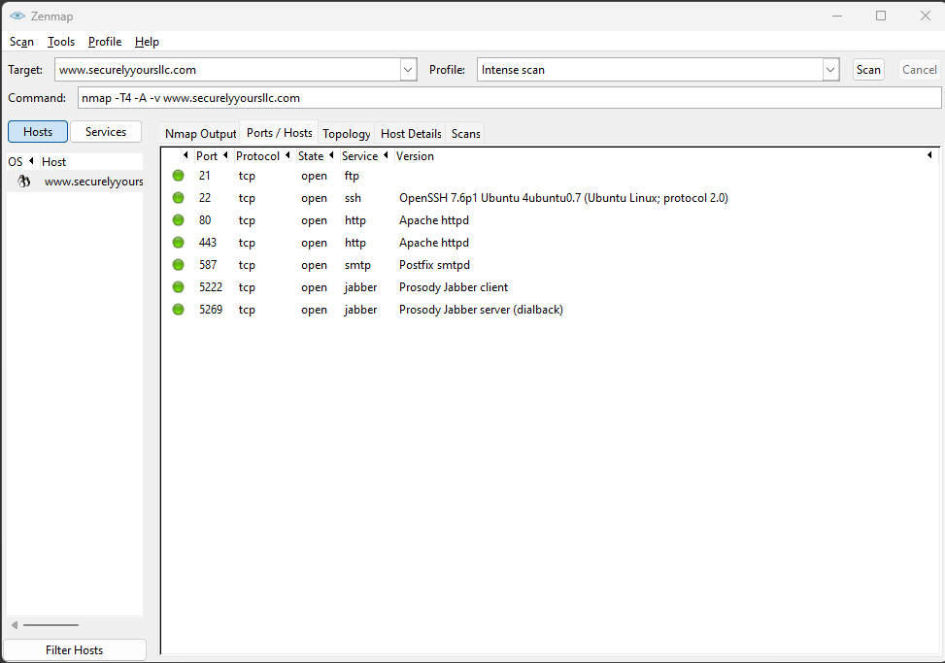
Nmap – Ports/Hosts

Slide 6
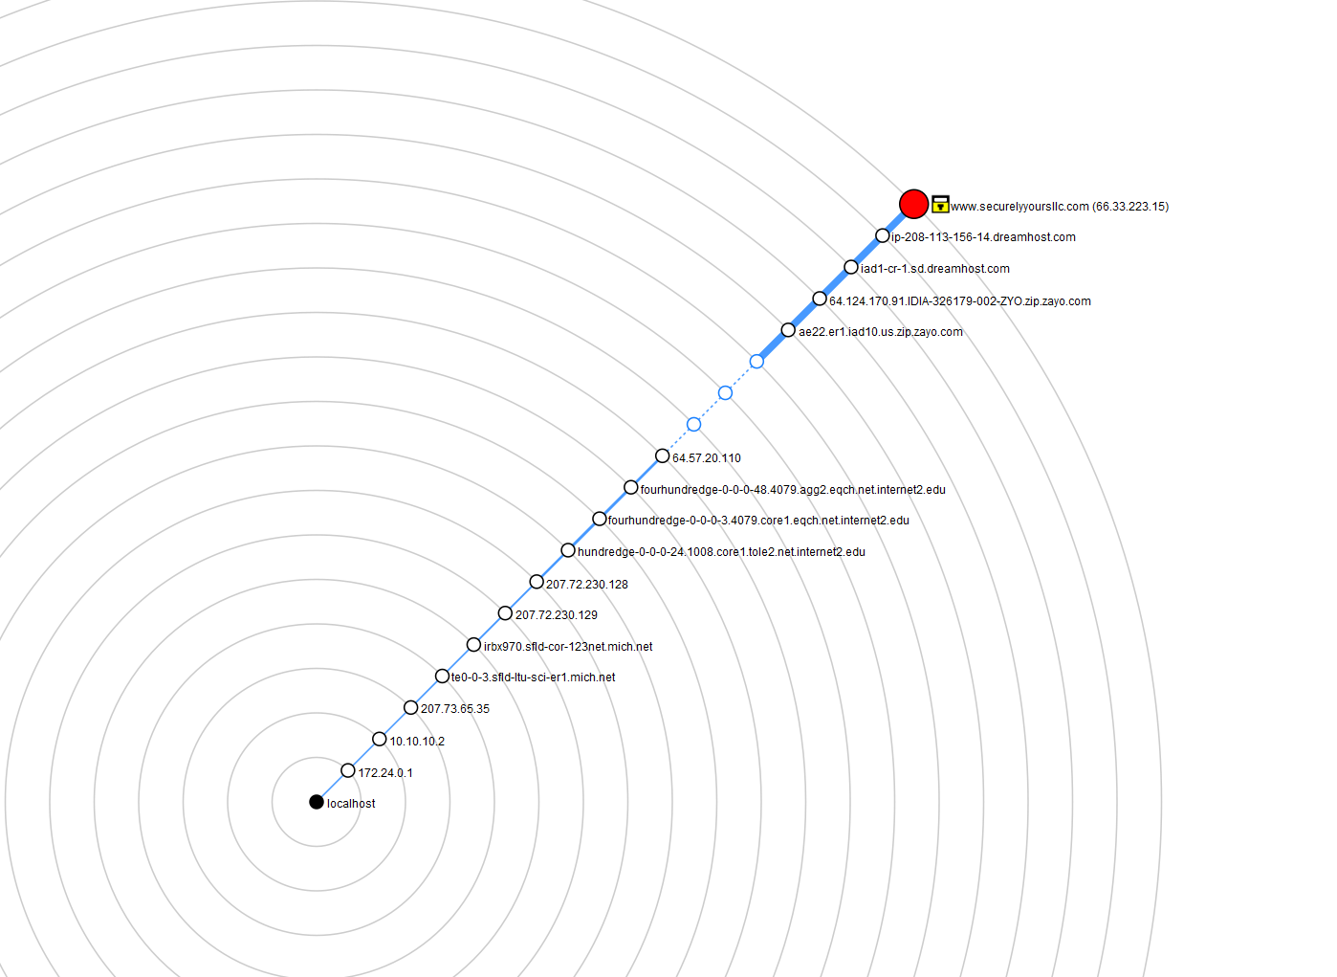
Nmap – Topology

Slide 7
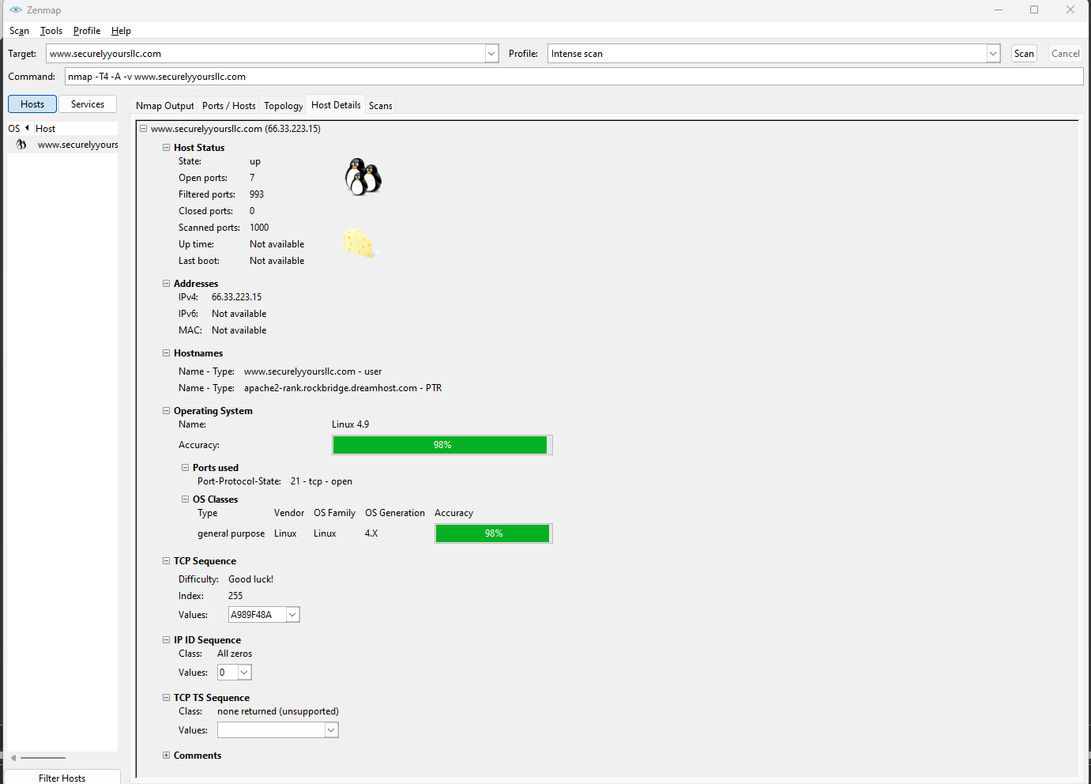
Nmap – Host details

